Slide 1
Closing Comments by the Applicant Group
Robert Vandervort, OD, FAAO, Dipl. ABO

Slide 2
Objectives of this presentation
How we satisfy each Criterion
Evidence to support our proposal
Address opposition arguments

Slide 3
Levels of Evidence as defined in Section 002.02
(A) Randomized trials;
(B) Comparison groups;
(C) Pre- vs. post-comparison;
(D) Correlation study;
(E) Case study;
(F) Anecdotal; and
(G) Other evidence as appropriate.

Slide 4
Criterion 1 and 2 go hand-in-hand
Criterion 1. The health, safety and welfare of the public are inadequately addressed by the present scope of practice or limitations on the scope of practice.
Criterion 2. Enactment of the proposed change in scope of practice would benefit the health, safety, or welfare of the public

Slide 5
Criterion 1: How does the scope restriction on SLT negatively impact the health, safety, or welfare of the public?
Level A evidence = Laser in Glaucoma and Ocular Hypertension Trial (The LiGHT Study)
This study determined that SLT is as effective as topical eye drops in lowering the intraocular pressure (IOP)and SHOULD be considered as first line therapy for glaucoma patients and certainly considered as second line therapy prior to adding a second or third eyedrop.
Therefore, in order for glaucoma patients to obtain the current, standard of care in the treatment of their glaucoma, they SHOULD have access to SLT as first or second option as opposed to eye drops.
The first negative impact of the restricted scope is that Nebraska patients have very limited access to SLT. See undisputed map of SLT locations.

Slide 6
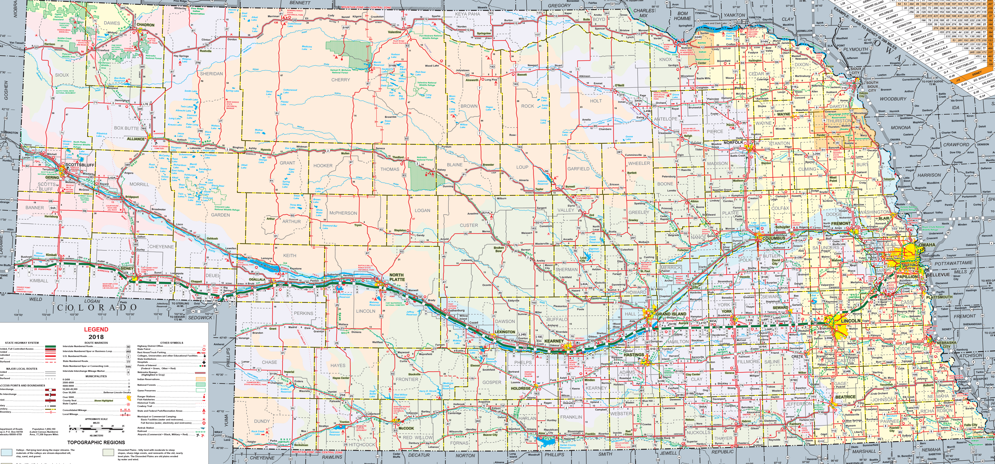
Current locations of SLT Lasers in Nebraska

Slide 7
The second issue negatively impacting the health and welfare of glaucoma patients in Nebraska
The unnecessary travel costs, duplication of care, loss of work, and stress on patients and families having to travel first to be evaluated and then return for their SLT
In this process the ophthalmologist repeats most, if not all, of the same testing and examination already performed by the referring doctor of optometry.
Because ophthalmologists typically block their laser schedules to certain days in their ASCs (so that a facility fee can be billed along with their professional fee)patients usually have to be scheduled back for their SLT.
This duplication of care and its associated costs are just as true for patients in Omaha or Lincoln as it is for greater Nebraska communities.
See Exhibit 9 and Pages 11&12 of the Proposal for more details

Slide 8
Criterion 2: How does removing the scope restriction on SLT resolve the problems identified in Criterion 1?
NOA membership survey indicates that at least 72 doctors of optometry across the state are likely or highly likely to provide SLT in their communities.
Level A evidence from the LiGHT study found that “SLT seems to be the most cost-effective first-line treatment option for glaucoma and ocular hypertension, also providing better clinical outcomes.”
Our opponents cite an ARVO Paper claiming that access to SLT was not enhanced in KY, LA, and OK based on driving time. However, based on number of communities actually added for SLT services significant gains were noted in all states.

Slide 9
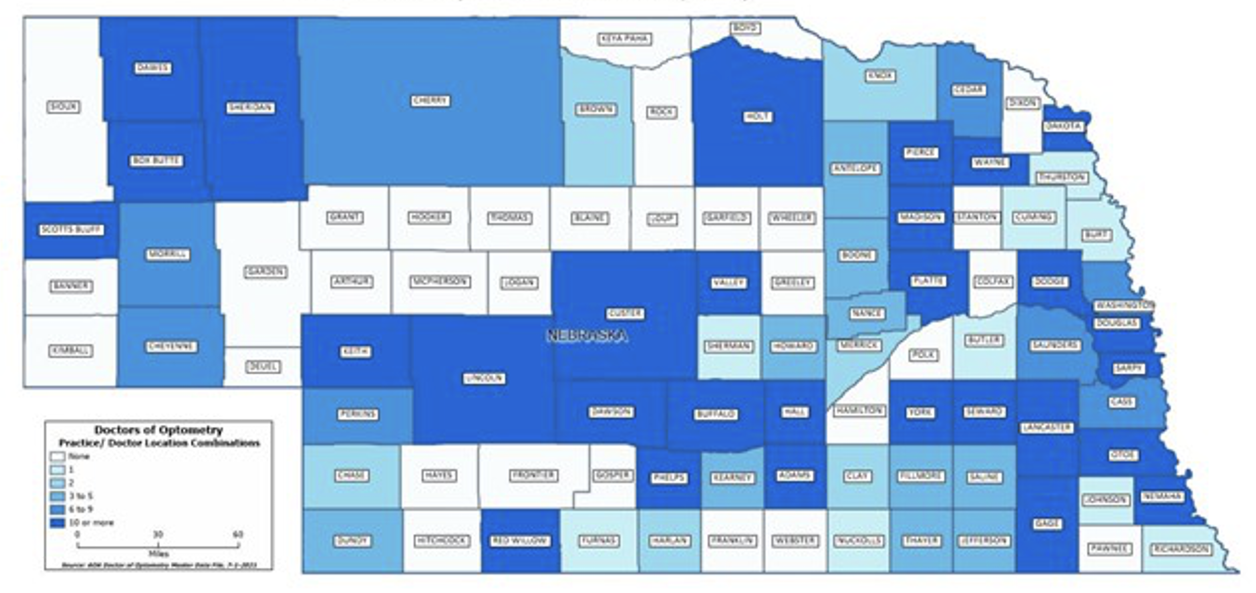
What does this translate to?
72 potential additional access points
Criterion 1 and 4

Slide 10
Criterion 2: How does removing the scope restriction on SLT resolve the problems identified in Criterion 1?
NOA membership survey indicates that at least 72 doctors of optometry across the state are likely or highly likely to provide SLT in their communities.
Level A evidence from the LiGHT study found that “SLT seems to be the most cost-effective first-line treatment option for glaucoma and ocular hypertension, also providing better clinical outcomes.”
Our opponents cite an ARVO Paper claiming that access to SLT was not enhanced in KY, LA, and OK based on driving time. However, based on number of communities actually added for SLT services significant gains were noted in all states.

Slide 11
Criterion 3: The proposed change in scope of practice does not create a significant new danger to the health, safety, or welfare of the public.
Sub-criteria a: Evaluation of physical, emotional, economic, or social danger to determine whether any evident danger would be created by the proposed change in scope of practice and significant enough to outweigh the benefits of implementing the proposed change in scope of practice.
Sub-criteria b: Evaluation of danger is based on the highest level of evidence available.

Slide 12
Evidence for safety of SLT being performed by doctors of optometry
Level A evidence from the LiGHT Study (and many other studies and papers) about the safety of the procedure itself
“Selective laser trabeculoplasty reduces intraocular pressure by increasing aqueous outflow through the trabecular meshwork with a single, painless outpatient laser procedure, minimal recovery time, and good safety profile.”
“We also demonstrate a greater safety of selective laser trabeculoplasty than previously reported, with low rates of selective laser trabeculoplasty-related adverse events.”

Slide 13
Level B Data comparing with other states demonstrates no issues of safety for optometrists performing SLT
Certified optometrists in Oklahoma, Kentucky, Louisiana, Arkansas, Indiana, Alaska, Wyoming, Colorado, and Virginia are authorized to perform SLT.
There has been no data or evidence presented to this Committee indicating issues of safety in any of those states.
Letters from the State Boards of Oklahoma, Kentucky, and Louisiana are attached to our Application attesting that there have been no disciplinary actions against optometrists regarding SLT.

Slide 14
Level B Data comparing with other states demonstrates no issues of safety for optometrists performing SLT
Independent reviews of national data by the Boards of Health from Washington State and Colorado revealed no issues of safety for optometrists performing SLT.
No state has ever rescinded or scaled back an enhancement of the scope of practice for optometry.
No disciplinary actions have ever been taken against a Nebraska optometrist for abusing or exceeding our scope of practice.

Slide 15
Our opponents have no evidence of significant evident danger
Sub-criteria (a) states that there must be “evident danger” created by the proposed change in scope of practice.
Sub-criteria (b) states that the evidence of danger must be “based on the highest level of evidence”.
Our opponents claim there is danger without any supporting data from states that have authorized doctors of optometry to perform SLTs.
Our opponents have expressed “fears” that patients that need more advanced glaucoma surgery will be delayed yet there is no epidemiological evidence anywhere in the country that optometrists are delaying patients getting to surgery.

Slide 16
Our opponents have no evidence of significant evident danger
Our opponents have a 45-year history in Nebraska of predicting harm and even death to patients with each and every enhancement in our scope of practice. These scare tactics have never come true in Nebraska or anywhere in the country.
This Credentialing Review Process was established by the Legislature to make recommendations based on evidence.

Slide 17
Criterion 4: The current education and training for the health profession adequately prepares practitioners to perform the new skill or service.
Sub-criteria (a): Analysis of the current education and training must show that it adequately prepares the practitioners in question to perform the new skill or service being proposed in a safe and effective manner.
Sub-criteria (b): Evidence must be presented to demonstrate that the current education and training is adequately and appropriately accredited.

Slide 18
Evidence that our Application Meets Criterion 4 and its associated sub-criteria
Statute fulfills Sub-criteria (b) by requiring that all education for licensure be provided by an accredited School or College of Optometry approved by the Board of Optometry.
Any optometrist seeking certification to perform SLT must meet all requirements outlined in our Application from an accredited institution.
Level B Data demonstrates that the certification requirements meet or exceed those in other states that authorize optometrists to perform SLTs with no reports of any competency or safety issues.
Our application requires proctoring in addition to what other states require for an added element of education, training, and safety.

Slide 19
Our opponents believe that determining whether our education is adequate involves a comparison to the education and training received by an ophthalmologist. However:
But that’s the wrong comparison. The Criterion does not ask how the education of one profession compares with another.
Optometric education is not identical to medical school education or an ophthalmology residency. But it doesn’t need to be.
The Criterion asks if the proposed education and training is adequate for this profession to perform this new skill.
Level B comparison data with other states clearly indicates that the training adequately prepares practitioners to perform SLT.

Slide 20
Optometry in Nebraska will be held to the same standard of care as an ophthalmologist in the performance of SLT. This will be true:
Statutorily
In malpractice cases
In disciplinary actions by DHHS and the Board of Optometry

Slide 21
Criterion 5 that asks the same question as Criterion 4 but as it relates to post-professional programs to train doctors who are already in practice. There are three sub-criteria.
Sub-criteria (a): There are programs in place and the programs show that they are adequate to ensure that the practitioners are able to perform the new skill or service being proposed in a safe and effective manner.
A certification program is available through an accredited College of Optometry that has been certifying optometrists to perform SLT for 20 years.
This accredited program has been used to certify Doctors of Optometry to perform SLT in Oklahoma, Kentucky, Louisiana, Alaska, Wyoming, Colorado, and Virginia.
Level B evidence from those states show no issues of competency or safety in implementing SLT with this accredited program.
Our proposal goes beyond these other states in requiring one-on-one proctoring of at least three patients prior to certification. Note: Wyoming also has a proctoring requirement.
The post-professional requirements are outlined in our Application in more detail

Slide 22
Criterion 5 that asks the same question as Criterion 4 but as it relates to post-professional programs to train doctors who are already in practice. There are three sub-criteria.
Sub-criteria (b): Evidence that demonstrates programs comply with acceptable standards
The previously described program in Sub-criteria (a) is administered by an accredited College of Optometry
Level B evidence from the Departments of Health and Boards of Optometry in Oklahoma, Kentucky, Louisiana, Alaska, Wyoming, Colorado, and Virginia all recognize this post-professional program as an acceptable standard.
Nebraska DHHS and the Board of Optometry will have the certifying authority to make sure any educational process complies with all acceptable standards.
Sub-criteria (c): Evidence presented that demonstrates programs are available and at a cost that is not prohibitive.
The cost of these programs is in line with other commonly available CME programs to certify optometrists to provide additional procedures.

Slide 23
Our opponents offer an opinion that optometric post-professional training is insufficient because it isn’t identical to ophthalmologists.
Again, that’s the wrong comparison. The Criterion does not ask how the education of one profession compares with another.
The Criterion asks if the proposed education and training is adequate for this profession to perform this new skill.
Level B comparison data with other states clearly indicates that the post-professional training adequately prepares practitioners to perform SLT.
Level B comparison data shows that other states licensing bodies recognize the proposed post-professional training as being adequate
20 year track record of success in training optometrists to perform SLT is available for public scrutiny

Slide 24
Optometry in Nebraska will be held to the same standard of care as an ophthalmologist in the performance of SLT. This will be true:
Statutorily
In malpractice cases
In disciplinary actions by DHHS and the Board of Optometry

Slide 25
Criterion 6 asks whether there are measures to assess competency and mechanisms in place to take appropriate action against a practitioner who is not performing the procedure competently.
Sub-criteria (a): Practitioners of the proposed new scope of practice must be subject to the complaint, investigation, and discipline provisions of the Uniform Credentialing Act.
This sub-criteria is automatically met since any legislation enacted will go through DHHS Rules and Regs process to ensure compliance with the UCA.
Sub-criteria (b): If the proposed new scope of practice will be implemented through the issuance of a new credential, and appropriate continuing competency requirements are established for the credential
A separate certification will be issued by the Department for SLT
Optometrists are required to complete a minimum of 44 hours of continuing education every biennium

Slide 26
Thank you!

