Slide 1
Section 4:
Moving the Needle on Vaccine Hesitancy

Slide 2
Vaccine Hesitancy
Specific populations have specific concerns

Slide 3
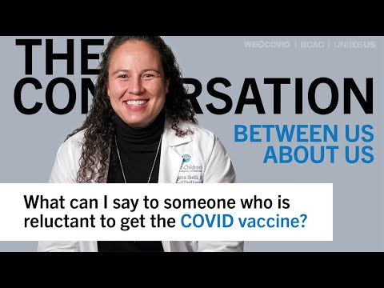
Talking About Vaccine Hesitancy

Slide 4
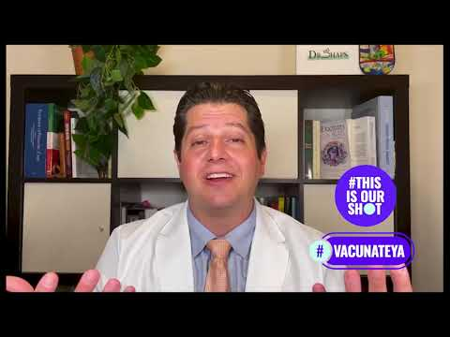
Vaccine Conversations with Cultural Understanding

Slide 5
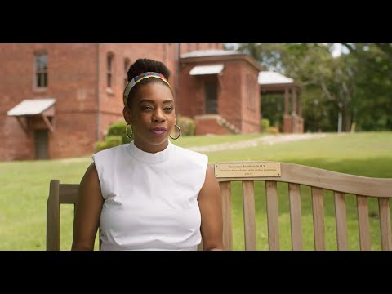
Historical Impacts: Tuskegee Misinformation

Slide 6
Your Role In Reducing Vaccine Hesitancy
You have the opportunity to be a trusted person others come to get their questions answered.
The coming slides will provide tips and resources to help you have COVID-19 vaccine conversations.
Every conversation you have with with someone still deciding to get vaccinated helps people become more confident in their choice.
More vaccine confidence leads more people in your community being protected.

Slide 7
Vaccine Conversations
A very important way you can help your community mitigate COVID-19

Slide 8
Conversations in Your Workplace
As part of this program you will be having conversations in your workplace with clients about COVID-19 prevention, vaccinations, etc.
These are very important to help people get questions answered and feel confident that they are protecting themselves, their families, and communities from the impacts of COVID-19.
Not everyone is ready to have these conversations, so we want you to focus on those that are still deciding if they should get vaccinated or not, or those that have questions about COVID-19 prevention.
You are a trusted member of your community so you have a very important role.

Slide 9
Prepare for Conversations in Your Workplace
Know your talking points.
Know the messaging/tone that resonates with your audience.
Don’t be afraid to share your story and why you chose to get vaccinated.
Remember to always listen and be empathetic.
Make sure to connect your client with resources to get their questions answered and sign-up for their vaccine when they are ready.
Keep track of the number of people you help get vaccinated. We want to make sure we can showcase the impact you are making in your community!

Slide 10
Vaccine Opportunities
There are many vaccine providers and vaccination events in your area

Slide 11
Details for Hosting Your Vaccine Event
If your business is planning to host a vaccine clinic, the Vax To Business team can help you connect to a vaccine provider in your area, and answer any questions. We want to make this easy for you!
Vaccine providers could be: a local health department, Federally Qualified Health Center (FQHC), local pharmacy, or Emergency Medical Services (EMS).
Your vaccine provider will work with you to organize the event, provide vaccines, and staff to administer vaccines.
You are expected to have staff from your business present at the vaccine event(s) you host for your community.
You will want to advertise for your vaccine event, take photos the day of and record necessary information to submit in the reporting form.

Slide 12
Other Vaccine Opportunities
We know that not every business will be hosting a vaccine event.
Even businesses that are hosting an event still need to know other locations they can refer clients to incase those clients can’t attend their event.
There are many resources available to easily find vaccine providers and vaccine events nearest you.

Slide 13
Vaccine Opportunities Near You
To find a vaccine near you:
Visit https://vaccinate.ne.gov/en-US/ or https://www.vaccines.gov/
You can also text your zip code to 438829 to get 3 vaccine sites near you
National COVID-19 Vaccination Assistance Hotline 1-800-232-0233. (TTY line 1-888-720-7489.)
You can also direct patrons to your nearest health department, FQHC, or IHS, to get assistance with finding a local vaccination:
Find the FQHC nearest you: https://findahealthcenter.hrsa.gov/
Find the IHS nearest you: https://www.ihs.gov/findhealthcare/
Find your local health department here: Local Health Department Map

Slide 14
Other Ways to Find a Vaccine
Many schools, churches, and other community organizations are hosting vaccine clinics. Information might be posted on information boards, inside community centers, on websites for your local chamber of commerce, or in newsletters for a local community organization.
Many pharmacies and clinics are also offering walk-in vaccines. Most have signs posted outside, and offer a phone number to call for more information.

Slide 15
Tips for Small Businesses & Employees
How you can leverage your unique role as a trusted messenger in your community

Slide 16
Small Business Guide
This guide is designed to help you:
Communicate with employees, workers and customers about the safety and benefits of COVID-19 vaccines, and reinforce the importance of masking and other safety measures to prevent the spread.
Make a plan to require or encourage your workers to get vaccinated at their earliest opportunity. This could include offering paid time off, transportation credits, child care or small incentives to workers who choose to get vaccinated.
Strengthen vaccination efforts in your community by offering help to public health departments, nonprofit organizations and others involved in the vaccine response.
View the rest of the resource here: HAA | Small Business Guide to COVID-19 Vaccines

Slide 17
Considering The Needs of Your Community
View the rest of the resource here:
Audience Insights & Messaging Guidance for Black, Hispanic, American Indian and Alaska Native Communities

Slide 18
Additional Messaging Resources
Communicating about vaccines with your own employees
HAA | Key Messages for Employees
Communicating with others about boosters
HHS | Communicating About COVID-19 Boosters

Slide 19
Section 4 Summary
You should know and be able to communicate:
How you in your unique role can move the needle on vaccine hesitancy and make a difference in your community.
Practical ways to have conversations about COVID-19 prevention and vaccines.
How to find a vaccine nearest you.

Slide 20
Complete Section 4
Please click the following link to get credit for this section, check your understanding, and receive your certificate of completion.
https://cip-dhhs.ne.gov/redcap/surveys/?s=WKLXYLKERX394TNT

