Slide 1
NNP Technical Review Committee #2 Karen Wenner, APRN, DNP Ann Young, APRN Jillian Negri, APRN, DNP Cora Schrader

Slide 2
Agenda 4/11/25
Goals
Restriction
Supervision/Conjunction Terms
Critical Access ER
Specialty Care Access
Risk Mitigation
Proposed Change
Summary/Questions

Slide 3
Goals of the 407 Review
Improve access to specialty care in Nebraska.
Remove barriers to allow nurse practitioners to practice to the full extent of education and training.
Define Nebraska state regulated training/education requirements for fluoroscopy.

Slide 4
Current Restriction
The Nebraska Board of Radiography recognizes a “Licensed Practitioner” as a person licensed to practice medicine, dentistry, podiatry, chiropractic, osteopathic medicine and surgery, or as an osteopathic physician.
A “licensed practitioner” may perform and supervise fluoroscopy without any further training requirements set forth by the state.

Slide 5
Supervision
Medical radiographer
Can perform diagnostic studies based upon order from a healthcare provider.
(e.g. x-ray, CT, nuclear medicine studies, ultrasound)
Cannot perform fluoroscopy without licensed practitioner present.
Licensed practitioner
May perform fluoroscopy independently or in conjunction with/directing/supervising a medical radiographer.
Medical radiographer typically will operate the larger C-arm, not the mini C-arm or in specialty settings.
CRNAs are required to have medical radiographer operating the fluoroscopy machine with their supervision.
CRNAs were not added as “licensed practitioner” due to conflicting recommendations/discussions.

Slide 6
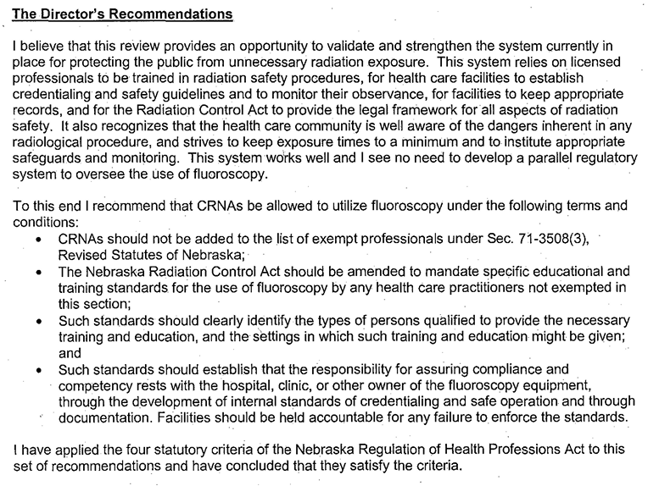
CRNA 407

Slide 7
Need for the Proposal: Patient access
Shortages of specialty services especially in rural communities
Limits patient access to care
Lack of ability to recruit trained specialists to Nebraska
Unnecessary work arounds
Prolonged procedures, repeat sedation/x-rays
Patient’s must travel for specialized procedures
Notes:
SHARE EXPERIENCES, OR/ER/IR Ellen

Slide 8
Critical Access ER
There are multiple sites where a nurse practitioner is the sole provider in the emergency department.
NPs are hired in the same role as physician assistants but cannot use fluoroscopy when indicated.
Notes:
SHARE EXPERIENCES, OR/ER/IR Ellen

Slide 9
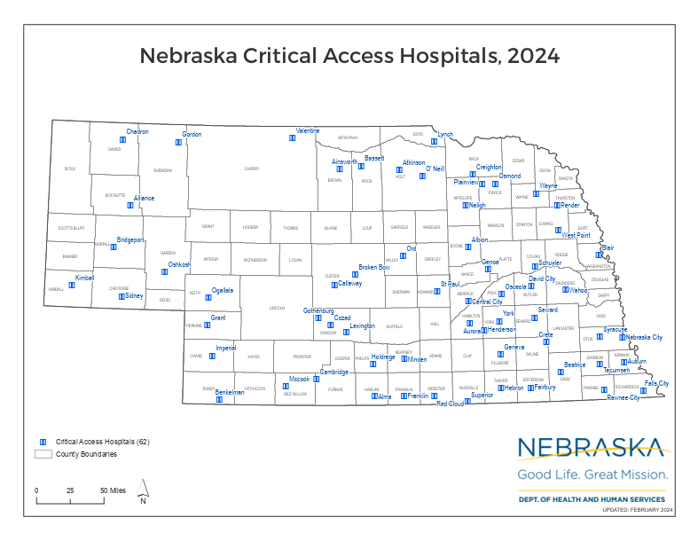
Critical Access ER
Notes:
SHARE EXPERIENCES, OR/ER/IR Ellen

Slide 10
Access to Specialty Care
The demand for procedures and specialty care is rising, while the shortage of medical providers continues to worsen.
Surgeons and physicians need qualified advanced practice providers to increase capacity of patient care being and procedures.
Physician assistants-1,150
Nurse Practitioners-3,951
NPs are uniquely situated to work and continue providing care in the hospitals and communities they started as a registered nurse.
Once fluoroscopy is legal, NP programs can include training and clinical sites. This will ideally increase staff retention in specialty areas.
Notes:
SHARE EXPERIENCES, OR/ER/IR Ellen

Slide 11
Risk Mitigation
“Med spas” or unlicensed facility concerns are already addressed by current statutes.
TITLE 180 - CONTROL OF RADIATION
CHAPTER 2 - REGISTRATION OF RADIATION GENERATING EQUIPMENT FACILITIES AND SERVICES
https://rules.nebraska.gov/rules?agencyId=37&titleId=109

Slide 12
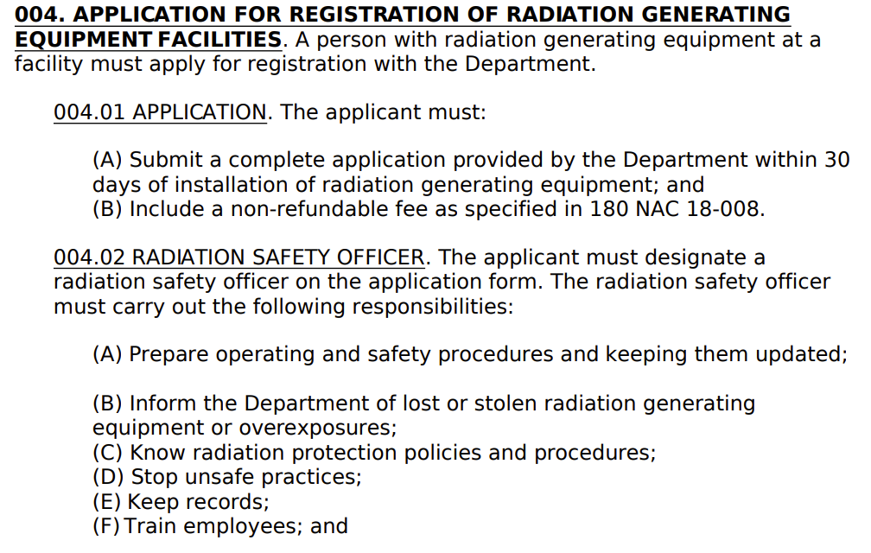
Risk Mitigation

Slide 13
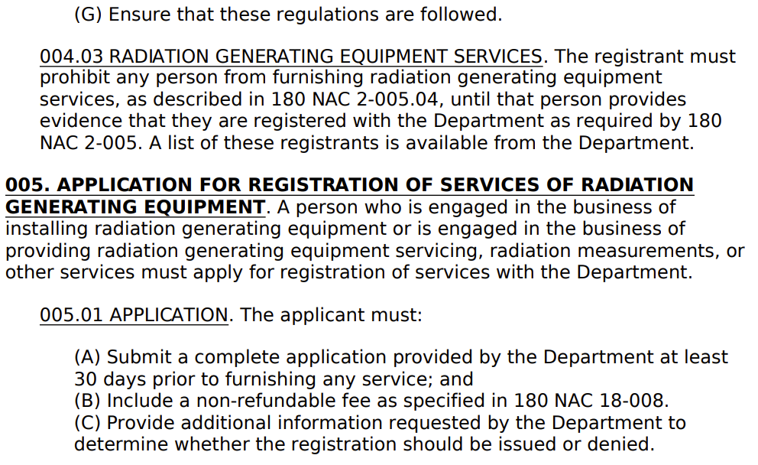
Risk Mitigation

Slide 14
Risk Mitigation

Slide 15
Risk Mitigation
012. OUT-OF-STATE RADIATION GENERATING EQUIPMENT. Whenever any radiation generating equipment registered in another state or by the federal government is to be brought into the State, for any temporary use, the person proposing to bring the equipment into the State must give written notice to the Department at least three working days before the equipment is to be used in the State. The notice must include the:
Type of radiation generating equipment; (B) Nature, duration, and scope of use; (C) Exact location or locations where the radiation generating equipment is to be used; and (D) State or states where the equipment is registered.
012.02 REQUIREMENTS FOR USE OF OUT-OF-STATE RADIATION GENERATING EQUIPMENT. A person referred to in 180 NAC 2-012 must:
(A) Comply with all applicable regulations of the Department;
(C) REVIEW OR CONSULTATION. Review or consultation includes area surveys, shielding reviews, and health physics consultations. A person performing review or consultation services of:
(i) Diagnostic radiation generating equipment other than computed tomography (CT) and cone beam computed tomography (CBCT) must meet the training requirements of 180 NAC 15-004.01, 180 NAC 15.004.02, or 180 NAC 15-004.03; (ii) Computed tomography (CT) or cone beam computed tomography (CBCT) must meet the training requirements of 180 NAC 15-004.01 or 180 NAC 15.004.02; (iii) Therapeutic radiation generating equipment must meet the training requirements of 180 NAC 15-004.01; and (iv) Non-medical radiation generating equipment must meet the training requirements of 180 NAC 15-004.02;

Slide 16
004.01 RADIOLOGICAL MEDICAL PHYSICIST.
A radiological medical physicist must:
Be certified by the American Board of Radiology in therapeutic radiological physics, roentgen ray and gamma ray physics, x-ray and radium physics; or radiological physics; or the American Board of Medical Physics in radiation oncology physics or the Canadian College of Medical Physics. Certification must be in the specialty the individual will be clinically practicing; or
(B) Have a master's or doctor's degree in physics, medical physics, other physical science, engineering, applied mathematics, nuclear physics, biophysics, radiological physics, or health physics and has completed one year of full time training in medical physics and an additional year of full time work experience under the supervision of a radiological medical physicist that meets the requirements of 180 NAC 15-004.01(A) at a medical institution. Full time training and full time work experience must be in the specialty the individual will be clinically practicing.

Slide 17
Proposed Change
NNP proposes to add Chapter 23 to Title 180 Radiation Control Act
NNP will remove the request to update the Medical Radiography Statute to include nurse practitioners as “licensed providers”.
This addresses the concerns by the BON for possible unintended consequences with other forms of radiation.

Slide 18
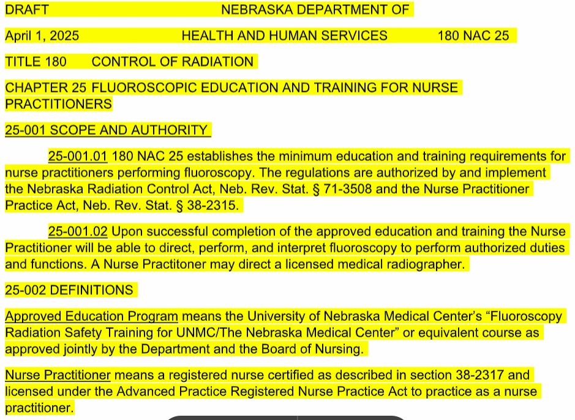

Slide 19
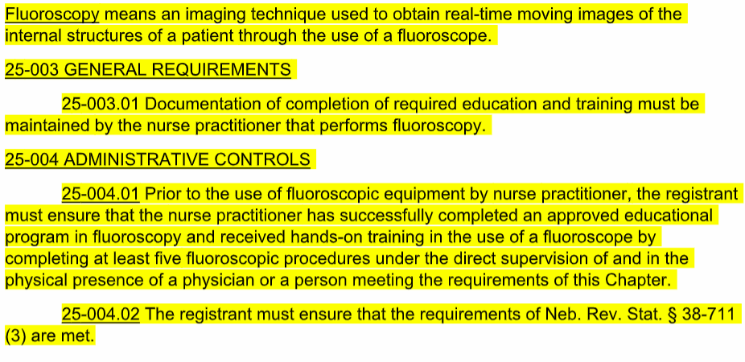
Notes:
004.01 RADIOLOGICAL MEDICAL PHYSICIST. A radiological medical physicist must:
(A) Be certified by the American Board of Radiology in therapeutic radiological physics, roentgen ray and gamma ray physics, x-ray and radium physics; or radiological physics; or the American Board of Medical Physics in radiation oncology physics or the Canadian College of Medical Physics. Certification must be in the specialty the individual will be clinically practicing; or (B) Have a master's or doctor's degree in physics, medical physics, other physical science, engineering, applied mathematics, nuclear physics, biophysics, radiological physics, or health physics and has completed one year of full time training in medical physics and an additional year of full time work experience under the supervision of a radiological medical physicist that meets the requirements of 180 NAC 15-004.01(A) at a medical institution. Full time training and full time work experience must be in the specialty the individual will be clinically practicing.

Slide 20
Proposed Education & Training
NNP proposes a minimum of 4 hours of post graduate didactic education in fluoroscopy which includes: radiation safety, radiation production and characteristics, radiobiology, contrast media, and fluoroscopic unit operation.
Clinical training must include a minimum of five fluoroscopic procedures under the supervision of a formally trained preceptor (e.g. radiologist, or other properly trained and licensed physician, physician assistants, NPs).
With each license renewal, a nurse practitioner who utilizes fluoroscopy must have a minimum of 1hour of continuing education (CME) in fluoroscopy.
Further training requirements may be set forth by the organization/fluoroscopy owner
Currently 22 other states allow nurse practitioners to utilize fluoroscopy and no significant adverse outcomes have been reported. Bordering states include Iowa, Colorado, and Wyoming- each with varying state regulated training requirements.

Slide 21
Thank you
Questions?

