Slide 1
NNP Technical Review Committee #3 Karen Wenner, APRN, DNP Ann Young, APRN Jillian Negri, APRN, DNP Cora Schrader

Slide 2
Agenda 5/2/25
Goals
Proposed Change
Radiation Dosage Comparisons
National Organization Review
Summary/Questions

Slide 3
Goals of the 407 Review
Improve access to specialty care in Nebraska.
Remove barriers to allow nurse practitioners to practice to the full extent of education and training.
Define Nebraska state regulated training/education requirements for fluoroscopy.

Slide 4
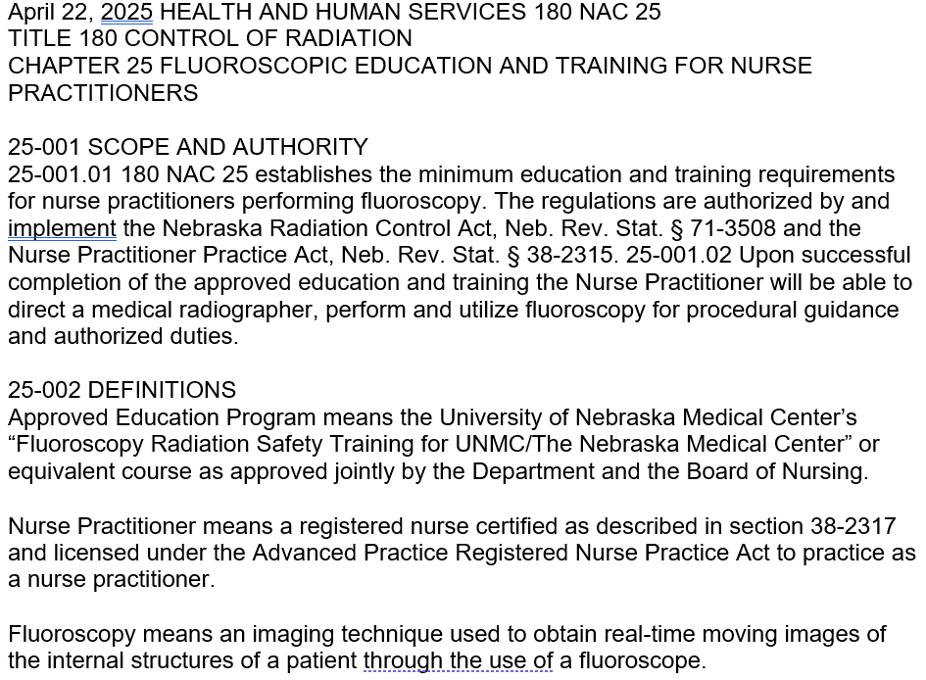

Slide 5
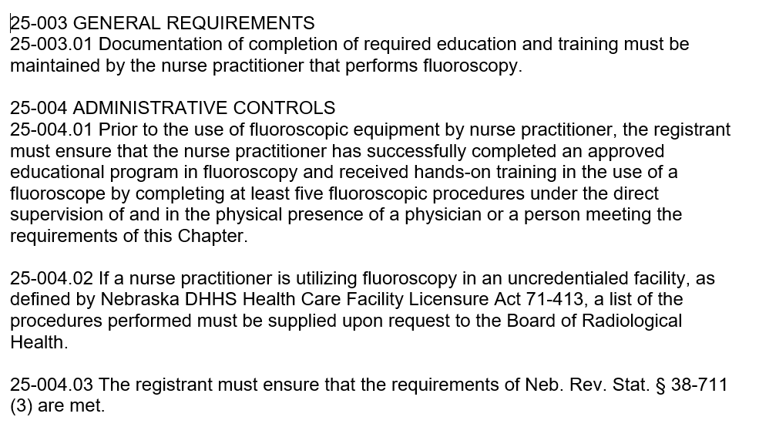

Slide 6
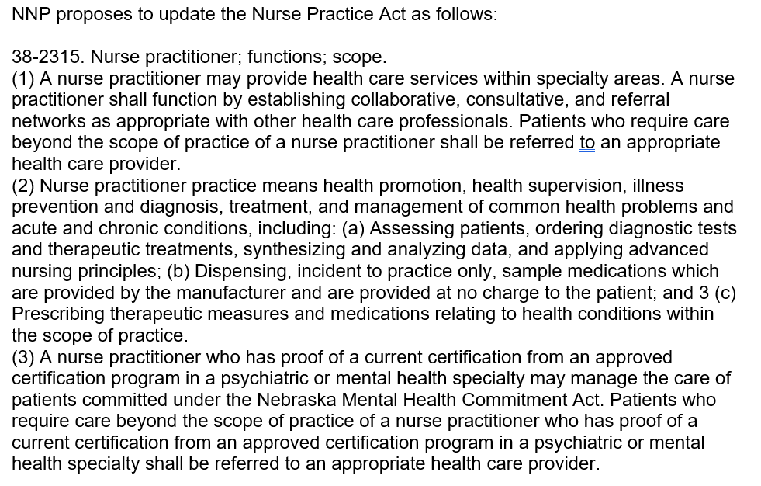

Slide 7
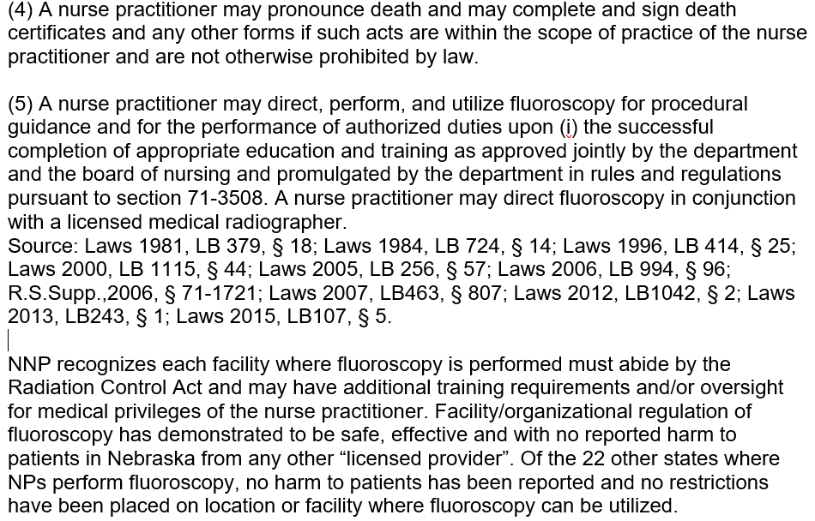

Slide 8
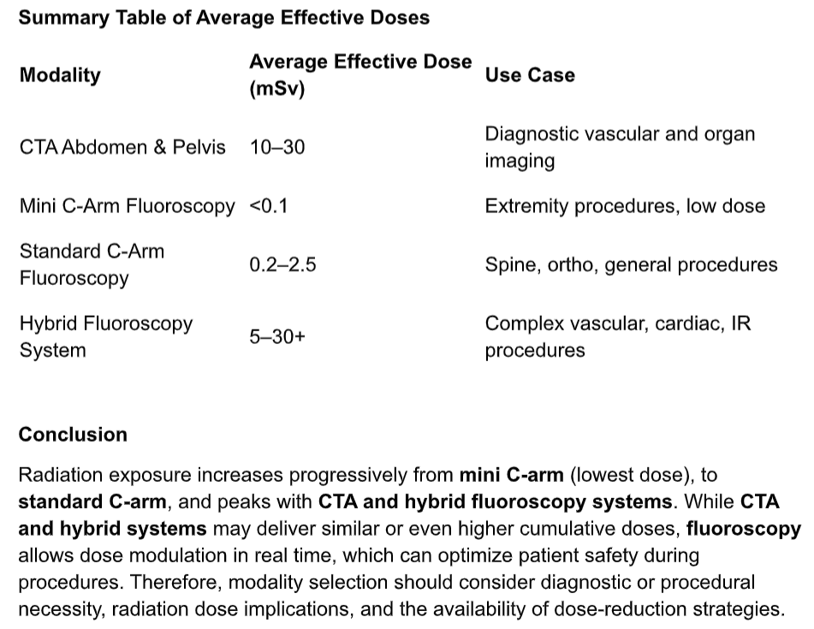
Radiation Dosage Comparison
Notes:
SHARE EXPERIENCES, OR/ER/IR Ellen

Slide 9
Notes:
SHARE EXPERIENCES, OR/ER/IR Ellen

Slide 10
Thank you
Questions?

