Slide 1
Welcome
_____ COUNTY:
Breast & Cervical Cancer Engagement Meeting
_____ __, 2025
Notes:
Link to post-meeting survey.

Slide 2


INTRODUCTIONS:
Instructions:
STEP 1:
Go to Slide #3 and #4
Share your Full Name
Share your Role & Organization
STEP 2:
Move to Slide #5 and #6 and type your W.I.N.N.
A W.I.N.N. (Weekly I Nurture and Network) in the last week is something that reminded you why your work in breast and cervical cancer prevention matters. A small win, story, or experience that reconnected you to the mission of improving screening rates.
Notes:
Welcome to the Lancaster County Breast and Cervical Cancer Engagement Meeting.
While we are waiting for people to get on the zoom you can go to slide 3 or 4 and enter your name and organization.
You may also go to slides 5 or 6 and enter a WINN that you’ve had for the week. A WINN is a moment from the past week that reminds you why your work in breast and cervical cancer prevention matters. WINN stands for “Weekly I Nurture and Network”
Within the chat is the link to the google slides. If you could please link to the slides it will be helpful as we start our meeting.

Slide 3

Welcome! Please check in below!
Full Name | Your Role/Organization
Notes:
While we are waiting for people to get on the zoom you can go to slide 3 or 4 and enter your name and organization.
You may also go to slides 5 or 6 and enter a WINN that you’ve had for the week. A WINN is a moment from the past week that reminds you why your work in breast and cervical cancer prevention matters. WINN stands for “Weekly I Nurture and Network”
Within the chat is the link to the google slides. If you could please link to the slides it will be helpful as we start our meeting.

Slide 4
Welcome! Please check in below!
Full Name | Your Role/Organization
Notes:
While we are waiting for people to get on the zoom you can go to slide 3 or 4 and enter your name and organization.
You may also go to slides 5 or 6 and enter a WINN that you’ve had for the week. A WINN is a moment from the past week that reminds you why your work in breast and cervical cancer prevention matters. WINN stands for “Weekly I Nurture and Network”
Within the chat is the link to the google slides. If you could please link to the slides it will be helpful as we start our meeting.

Slide 5
What is your W.I.N.N.?
(Weekly I Nurture and Network)
Type Your W.I.N.N. Here
Type Your W.I.N.N. Here
Type Your W.I.N.N. Here
Type Your W.I.N.N. Here
Type Your W.I.N.N. Here
Type Your W.I.N.N. Here
Type Your W.I.N.N. Here
Type Your W.I.N.N. Here
Type Your W.I.N.N. Here
Type Your W.I.N.N. Here
Type Your W.I.N.N. Here
Type Your W.I.N.N. Here
Type Your W.I.N.N. Here
Type Your W.I.N.N. Here
Type Your W.I.N.N. Here
Type Your W.I.N.N. Here
Type Your W.I.N.N. Here
Type Your W.I.N.N. Here
Type Your W.I.N.N. Here
Type Your W.I.N.N. Here

Slide 6
What is your W.I.N.N.?
(Weekly I Nurture and Network)
Type Your W.I.N.N. Here
Type Your W.I.N.N. Here
Type Your W.I.N.N. Here
Type Your W.I.N.N. Here
Type Your W.I.N.N. Here
Type Your W.I.N.N. Here
Type Your W.I.N.N. Here
Type Your W.I.N.N. Here
Type Your W.I.N.N. Here
Type Your W.I.N.N. Here
Type Your W.I.N.N. Here
Type Your W.I.N.N. Here
Type Your W.I.N.N. Here
Type Your W.I.N.N. Here
Type Your W.I.N.N. Here
Type Your W.I.N.N. Here
Type Your W.I.N.N. Here
Type Your W.I.N.N. Here
Type Your W.I.N.N. Here
Type Your W.I.N.N. Here

Slide 7
TODAY’S AGENDA
:10 | Welcome/Introductions
:05 | Intentions & Group Agreements
:40 | Guided Data Review & Analysis
:05 | Survey Results Summary
:05 | Nebraska & Lancaster County Data Review
:15 | Small Group Discussion on Datasets
:15 | Plenary Discussion on Insights and Key Findings
:05 | BREAK
:55 | Brainstorm/Idea Generation
:05 | Brainstorming Instructions (Brainstorming / Dots / Contributions)
:10 | Brainstorming: Access AND Screening
:10 | Brainstorming: Education/Outreach
:10 | Brainstorming: Provider Engagement
:10 | Brainstorming: Other/Non-Traditional
:10 | Closing & Reflection
:02 | Post-Meeting Survey
:03 | Closing & Next Steps
:05 | Final Thoughts
Notes:
SLIDE 7
We will briefly go over the agenda.
We do have 2 ½ hours scheduled for the meeting but we will more than likely be done sooner than that.
We will try our best to adhere to the agenda and timeframes but if there’s a great discussion happening we may need to adapt it a bit.
Welcome and Introductions – which we’ve done already
We will review Intentions of the meeting and group agreements.
Review and current data that we have and break into 2 groups to dissect some of that data
We will take a short break and when we return we will review 5 key areas around screening. We will brainstorm as a group during this session.
Then we will discuss the post meeting survey, closing and next steps.

Slide 8
Objectives
What are our aims today?
Understand county-level data on breast and cervical cancer screening, disease burden, and broader factors that influence health outcomes.
Identify gaps in access to screening and follow-up services for eligible populations.
Generate ideas for increasing program enrollment and screening uptake within priority communities.
Notes:
SLIDE 8
we will talk about our objectives –
We are aiming to understand county-level data on breast and cervical cancer screening, disease burden and other factors that influence health outcomes.
Identify any gaps in access to screening/follow up services
Generate ideas for increasing screening and enrollment.

Slide 9

Shared Agreements
What agreements will help us work together online?
Be present
Practice “both/and” thinking
It’s okay to disagree in a respectful way
Make space, take space
What’s said, stays; what’s learned, leaves
All learners, all wise
The whole is greater than the sum of its parts
Notes:
SLIDE 9: Chat will be enabled and engaging;
Some shared agreements that will help us work together online –
Try to be present
Practice both/and thinking – which means we just recognize and embrace opposing ideas or perspectives
It’s okay to disagree – respectfully
Create room for others
What’s said stays here and what’s learned, leaves
We are all learners and we are all wise
The whole is greater than the sum of it’s part – come together and create something bigger/better.

Slide 10
Pre-Meeting Survey Results Summary
Current Top Supports for Access to Screening:
Education/Outreach Campaigns - 86%
Clinic reminder systems - 86%
Navigation assistance for accessing screening, follow-up, and treatment - 57%
Transportation or mobile screening options - 43%
Bilingual staff/translated materials - 43%
Community Health Workers/Trusted Messengers - 29%
Peer support or survivor advocates - 14%
Barriers to Screening for Women aged 21-34:
Transportation – 43%
Lack of awareness of outreach - 29%
Provider access or availability - 14%
Barriers to Screening for Women aged 35 and over
Transportation – 33%
Lack of awareness of outreach - 33%
Confusion about eligibility or cost - 17%
Suggestions to Strengthen Relationships with EWM
Provider Engagement
Continue to communicate; provide trainings for providers; stop in at provider offices to check in/train
Media/Marketing Campaign
Create standardized referral system including onboarding new clinical staff
Assist in over the phone applications - removal of signature line if possible?
Receiving program contacts and patient referral info
Need assistance in finding ways to assist those that are undocumented for mammography
Potential Organizational Contributions
Communications and outreach support
Staff time
Find partners who can help diversify funding sources, more community collaborators or stakeholders
*9 survey respondents
Notes:
Everyone was asked to fill out a pre-meeting survey. We had just 9 people respond and here were some of the results:
Briefly the current top support for access to screening include:

Slide 11
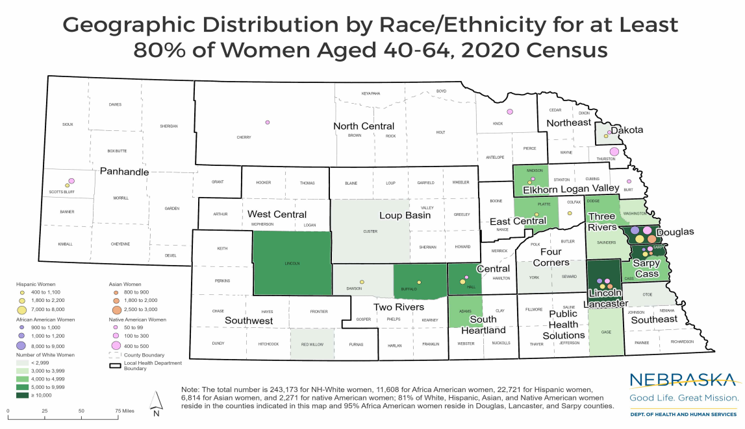
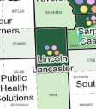
Our Purpose & Possibilities
Notes:
SLIDE 11-15:Melissa Leypoldt, Program Director for Women’s and Men’s Health will discuss the data on the next few slides

Slide 12
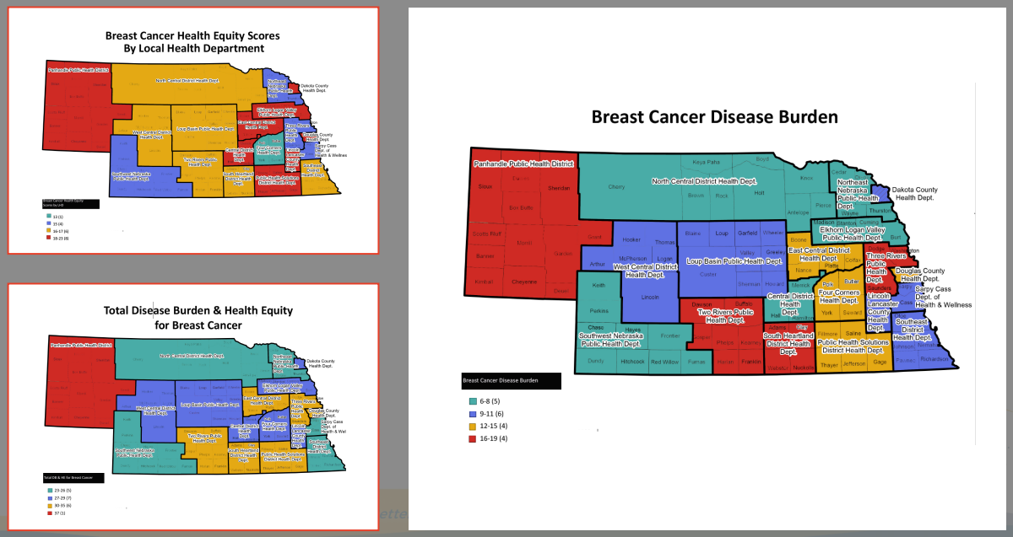
Our Purpose & Possibilities
Notes:
DHHS Staff - Melissa L.

Slide 13
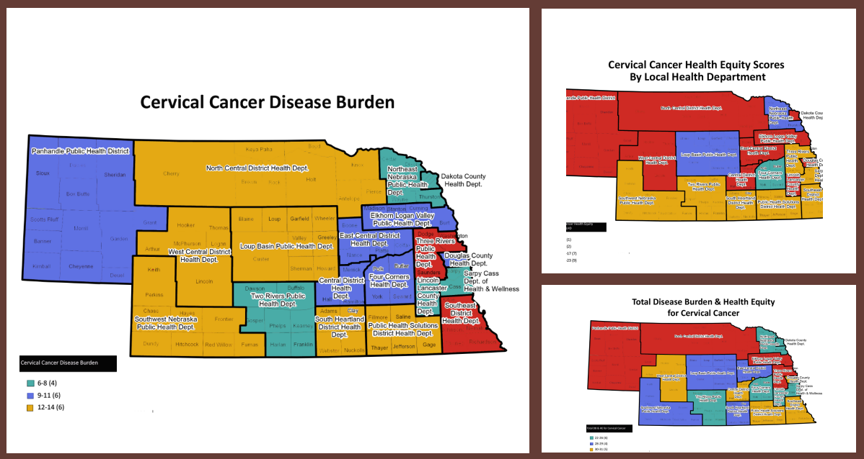
Our Purpose & Possibilities
Notes:
DHHS Staff - Melissa L.

Slide 14

Focus Question
What patterns, gaps, and possibilities
can we uncover as we explore this data together?
Notes:
SLIDE 16: If you move to Slide 16 we will look at our Focus Question of the day –
“What patterns, gaps and possibilities can we uncover as we explore this data together?”
This question guides our engagement with the data and helps focus our attention and frame our study in a purposeful way.

Slide 15
Goals of Our Partner Engagement
Our goal is to engage key partners in examining county-level disparities in screening rates and access. Together we’ll co-create data-informed strategies to increase Every Woman Matters enrollment and advance equitable health outcomes across Nebraska.
Goals of Our Data Review
As we engage in our Data Review, we want to understand:
The patterns, gaps, and possibilities this data reveals about screening, access, and equity.
How can these insights help us develop focused strategies that will drive equitable access, increase program enrollment, and strengthen collaboration for measurable impact?
Data Review Groups
Group A | Slides 18-21 | Lancaster County
Group B | Slides 22-25 | Lancaster County
Notes:
SLIDE 17:
We are going to break up into 2 groups – Group A and Group B.
We will be looking at the same data.
Our goal is to review the data and see what patterns we can discover, what gaps can we see, what are possibilities that we see or maybe don’t see.
As you get into your groups you will have a facilitator.
Review the data
In the first section you’re going to come up with at least 3-4 key points that you want the other group to understand about the data.
Take time to drag a green dot to data points that catch your attention.
See what stands out to you? Anything you’re curious about?
What are barriers that you see? What might this data not be telling us?
We will have 15 minutes on this activities.
If you have time in your groups you can choose the top 4 key points and move them down to SLIDE 26
If you have time in your groups you can choose the top 4 recommendations and move them down to SLIDE 27
GROUP A: SLIDES 18-21 – Tracey and Lynn
GROUP B: SLIDES 22-25 – Melissa and Tina
If we have time we will discuss the key points and recommendations before we go on a quick break.

Slide 16
GROUP A: LANCASTER COUNTY DATA PROFILE
Review the Data for Lancaster County
Slide 18: capture on stickies what the larger group needs to understand and implications
Slides 19-21: review population, health, SDOH, eligibility, etc. data
Synthesize your answers into 3-4 key points the larger group needs to understand from this data. Type the key points on the stickies below:
What are recommendations for our work? Type them on the stickies below:
Instructions
Review data from your assigned County.
Drag a dot to data points that particularly catch your attention.
Consider questions like:
  What patterns or disparities stand out to you?
  Where do you see the biggest gaps between need and access?
  What are you curious about? How does this align (or not) with your experience?
  How does this data resonate with what you’ve seen or heard from clients or partners?
  What social or structural barriers might be contributing to these outcomes?
  What might this data not be telling us?
Spend 15 minutes on this activity
Transfer your key points and recommendations to the stickies on SLIDES 26-27
Notes:
Tracey and Lynn

Slide 17
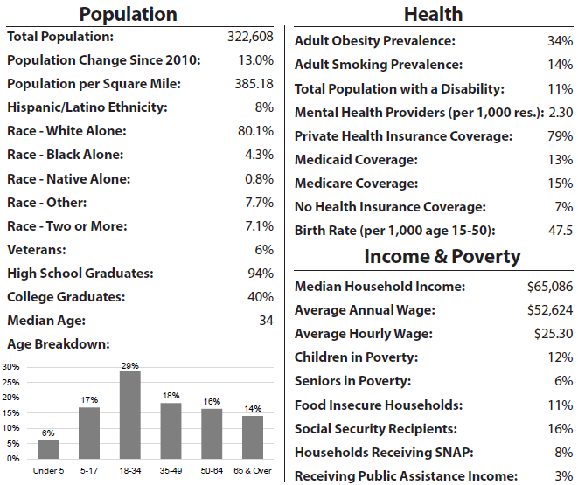
Lancaster County Data Profile
Drag a dot (click the dot and hold down left mouse button) to any data points that particularly catch your attention
Drag a dot (click the dot and hold down left mouse button) to any data points that particularly catch your attention
Instructions
Review data from your assigned County.
Drag a dot to data points that particularly catch your attention.
Consider questions like:
  What patterns or disparities stand out to you?
  Where do you see the biggest gaps between need and access?
  What are you curious about? How does this align (or not) with your experience?
  How does this data resonate with what you’ve seen or heard from clients or partners?
  What social or structural barriers might be contributing to these outcomes?
  What might this data not be telling us?

Slide 18
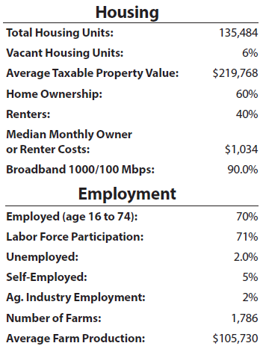
Lancaster County Data Profile
Drag a dot (click the dot and hold down left mouse button) to any data points that particularly catch your attention
Instructions
Review data from your assigned County.
Drag a dot to data points that particularly catch your attention.
Consider questions like:
  What patterns or disparities stand out to you?
  Where do you see the biggest gaps between need and access?
  What are you curious about? How does this align (or not) with your experience?
  How does this data resonate with what you’ve seen or heard from clients or partners?
  What social or structural barriers might be contributing to these outcomes?
  What might this data not be telling us?

Slide 19
Lancaster County Data Profile
Drag a dot to any data points that particularly catch your attention
Additional screening related data:
Mammography Screening Rate: 66.9%
Breast Cancer Mortality: >18.4 to 22.7
Cervical Cancer Screening Rate: >69.3 to 71.7
Participating EWM Provider Clinics: 29
Physical Inactivity: 21%
Program-Eligible Female Population Distribution for Breast Cancer Screening: 2049
Program-Eligible Female Population Distribution for Cervical Cancer Screening: 5882
Notes:
State Mammography Rate: 67.6%
National Mammography Rate: 70.2%
Mammography Rate GOAL: 76%
State Breast Cancer Mortality Rate: 19.5%
National Breast Cancer Mortality Rate: 19.3%
Breast Cancer Mortality Rate GOAL: 15.3%
State Cervical Cancer Screening Rates: 77.7%
National Cervical Cancer Screening Rate: 77.7%
Cervical Cancer Screening GOAL: 84%

Slide 20
GROUP B: LANCASTER COUNTY DATA PROFILE
Review the Data for Lancaster County
Slide 22: capture on stickies what the larger group needs to understand and implications
Slides 23-25: review population, health, SDOH, eligibility data
Synthesize your answers into 3-4 key points the larger group needs to understand from this data. Type the key points on the stickies below:
What are recommendations for our work? Type them on the stickies below:
Instructions
Review data from your assigned County.
Drag a dot to data points that particularly catch your attention.
Consider questions like:
  What patterns or disparities stand out to you?
  Where do you see the biggest gaps between need and access?
  What are you curious about? How does this align (or not) with your experience?
  How does this data resonate with what you’ve seen or heard from clients or partners?
  What social or structural barriers might be contributing to these outcomes?
  What might this data not be telling us?
Spend 15 minutes on this activity
Transfer your key points and recommendations to the stickies on SLIDES 26-27
Notes:
Melissa and Tina

Slide 21
Lancaster County Data Profile
Drag a dot (click the dot and hold down left mouse button) to any data points that particularly catch your attention
Drag a dot (click the dot and hold down left mouse button) to any data points that particularly catch your attention
Instructions
Review data from your assigned County.
Drag a dot to data points that particularly catch your attention.
Consider questions like:
  What patterns or disparities stand out to you?
  Where do you see the biggest gaps between need and access?
  What are you curious about? How does this align (or not) with your experience?
  How does this data resonate with what you’ve seen or heard from clients or partners?
  What social or structural barriers might be contributing to these outcomes?
  What might this data not be telling us?

Slide 22
Lancaster County Data Profile
Drag a dot (click the dot and hold down left mouse button) to any data points that particularly catch your attention
Instructions
Review data from your assigned County.
Drag a dot to data points that particularly catch your attention.
Consider questions like:
  What patterns or disparities stand out to you?
  Where do you see the biggest gaps between need and access?
  What are you curious about? How does this align (or not) with your experience?
  How does this data resonate with what you’ve seen or heard from clients or partners?
  What social or structural barriers might be contributing to these outcomes?
  What might this data not be telling us?

Slide 23
Lancaster County Data Profile
Drag a dot to any data points that particularly catch your attention
Additional screening related data:
Mammography Screening Rate: 66.9%
Breast Cancer Mortality: >18.4 to 22.7
Cervical Cancer Screening Rate: >69.3 to 71.7
Participating EWM Provider Clinics: 29
Physical Inactivity: 21%
Program-Eligible Female Population Distribution for Breast Cancer Screening: 2049
Program-Eligible Female Population Distribution for Cervical Cancer Screening: 5882
Notes:
State Mammography Rate: 67.6%
National Mammography Rate: 70.2%
Mammography Rate GOAL: 76%
State Breast Cancer Mortality Rate: 19.5%
National Breast Cancer Mortality Rate: 19.3%
Breast Cancer Mortality Rate GOAL: 15.3%
State Cervical Cancer Screening Rates: 77.7%
National Cervical Cancer Screening Rate: 77.7%
Cervical Cancer Screening GOAL: 84%

Slide 24
Data Review KEY POINTS Report Out
GROUP A: KEY POINTS
GROUP A: KEY POINTS
GROUP A: KEY POINTS
GROUP A: KEY POINTS
GROUP B: KEY POINTS
GROUP B: KEY POINTS
GROUP B: KEY POINTS
GROUP B: KEY POINTS

Slide 25
Data Review RECOMMENDATIONS Report Out
GROUP A: Recommendations
GROUP A: Recommendations
GROUP A: Recommendations
GROUP A: Recommendations
GROUP B: Recommendations
GROUP B: Recommendations
GROUP B: Recommendations
GROUP B: Recommendations

Slide 26


TIME FOR A 5 MINUTE BREAK!
Notes:
Please turn off the video and mute the sound on your Zoom. See you back in 5 minutes!

Slide 27


Welcome Back!
Let’s Brainstorm!
What are the ROADBLOCKS and what are the POSSIBLE SOLUTIONS?
Notes:
SLIDE 29: Brainstorming Session where we will look at the roadblocks and come up with possible solutions.

Slide 28

Brainstorming Session
What if you had a Magic Wand?
What solutions can we come up with?
What’s another way to work creatively with a
problem?
What are your ideas that would solve the problem?
What are potential solutions or action steps?
Notes:
SLIDE 30:
During the brainstorming session – think if you have a magic wand what solutions could we come up with.
Time, capacity, money were not object - how would you wave your magic wand to ensure women get screened?
Is there another way to work creatively with the problem?
What are your ideas?
What are solutions?

Slide 29
Brainstorming Session
What do you think would work?
How might we ensure women in
Lancaster County to get screened for breast and cervical cancer?
Notes:
SLIDE 31: Question we are brainstorming: How might we ensure women in LANCASTER COUNTY to get screened for breast and cervical cancer?
SLIDE 32-25 We are going to work together as a whole group and brainstorm ideas around 5 key areas:
ACCESS (transportation/gas vouchers/night appointments)
SCREENING (follow up/list)
EDUCATION/OUTREACH (where are they? Messaging ideas? Campaigns?)
PROVIDER ENGAGEMENT (training/provider visits/drop ins)
OTHER / NON-TRADITIONAL (person of interest, compelling story, coffee shops, school drop off/worksites)
Feel free to place your ideas in the brainstorming boxes on the left. We will have 7 minutes to do this – if we need to clarify anything that is stated we can do that as well.
Next we will take 1 minute to drag green dots to anything that you feel is a great idea.
The third step will be to take 2 minutes to fill out what you might be excited about and maybe how you or your organization can contribute the any idea

Slide 30
Brainstorming: Access and Screening
How might we ensure women in Lancaster County access
Services and get screened for breast and cervical cancer?
STEP 1: Place your ideas in the boxes below
STEP 2:
Drag a dot to any great idea
STEP 3: Place your name and what you’re excited about and what you or your organization could contribute
ACCESS
Name/Organization | Contribution/Commitment
Notes:
Transportation = gas vouchers; night appointments
Feel free to place your ideas in the brainstorming boxes on the left. We will have 7 minutes to do this – if we need to clarify anything that is stated we can do that as well.
Next we will take 1 minute to drag green dots to anything that you feel is a great idea.
The third step will be to take 2 minutes to fill out what you might be excited about and maybe how you or your organization can contribute the any idea

Slide 31
Brainstorming: Education/Outreach
How might we provide education and/or outreach to women in Lancaster County? Where? What messages should we be saying?
STEP 1: Place your ideas in the boxes below
STEP 2:
Drag a dot to any great idea
STEP 3: Place your name and what you’re excited about and what you or your organization could contribute
EDUCATION/OUTREACH
Name/Organization | Contribution/Commitment
Notes:
Where are they? Messaging ideas? Campaigns?
Feel free to place your ideas in the brainstorming boxes on the left. We will have 7 minutes to do this – if we need to clarify anything that is stated we can do that as well.
Next we will take 1 minute to drag green dots to anything that you feel is a great idea.
The third step will be to take 2 minutes to fill out what you might be excited about and maybe how you or your organization can contribute the any idea

Slide 32
Brainstorming: Provider Engagement
How might we ensure providers in Lancaster County continue to be engaged in their clients’ preventive care?
STEP 1: Place your ideas in the boxes below
STEP 2:
Drag a dot to any great idea
STEP 3: Place your name and what you’re excited about and what you or your organization could contribute
PROVIDER ENGAGEMENT
Name/Organization | Contribution/Commitment
Notes:
Training; provider visits - drop ins?
Feel free to place your ideas in the brainstorming boxes on the left. We will have 7 minutes to do this – if we need to clarify anything that is stated we can do that as well.
Next we will take 1 minute to drag green dots to anything that you feel is a great idea.
The third step will be to take 2 minutes to fill out what you might be excited about and maybe how you or your organization can contribute the any idea

Slide 33
Brainstorming: Other/Non-Traditional
What are other, non-traditional ways we can ensure women in Lancaster County access get screened for breast and cervical cancer?
STEP 1: Place your ideas in the boxes below
STEP 2:
Drag a dot to any great idea
STEP 3: Place your name and what you’re excited about and what you or your organization could contribute
OTHER/NON-TRADITIONAL
Name/Organization | Contribution/Commitment
Notes:
Person of interest, compelling story, coffee shops, school drop off, worksites?
Feel free to place your ideas in the brainstorming boxes on the left. We will have 7 minutes to do this – if we need to clarify anything that is stated we can do that as well.
Next we will take 1 minute to drag green dots to anything that you feel is a great idea.
The third step will be to take 2 minutes to fill out what you might be excited about and maybe how you or your organization can contribute the any idea

Slide 34

Post-Meeting Survey
Post-meeting survey:
https://www.surveymonkey.com/r/8-14-25BCEngagementPOSTSurvey
Notes:
SLIDE 37: Post-meeting survey
In all that we do we really want to gather your input on how today went. Your feedback is greatly appreciated so the remaining 4 meetings that we will be holding across the state are more effective. Please take just a minute to either scan the QR code, click on the url link or in the chat is the link as well.
There are less than 10 questions.
We would greatly appreciate it.

Slide 35
Closing & Next Steps
Post-meeting survey:
https://www.surveymonkey.com/r/8-14-25BCEngagementPOSTSurvey
NEXT STEPS:
Compile Breast & Cervical Cancer Engagement Meeting Notes and Ideas
Synthesis AND Prioritization Meeting (DHHS Staff): August 18th
  Develop one-pager for Lancaster County: Future Objectives and Priorities
  Compile all information, objectives and priorities for all regional meetings into a Statewide Engagement Plan
Distribute to group meeting summary/notes, Lancaster County One-Pager (please respond with feedback)
Notes:
SLIDE 38: Melissa to reiterate the post meeting survey
Next steps - we will compile the notes from this meeting
August 18 DHHS staff will review the notes and prioritize the ideas and develop a one-pager for Lancaster County – future objectives and priorities.
We will then send the summary and the one-pager out to this group to review and comment on.

Slide 36
Final Thoughts What’s your takeaway - from Head to Toe?
🧠
New Idea or insight you’re taking away
👂
Something important you want to remember
👀
What did you see more clearly
🍽
Something that didn’t sit right/gave you pause
👣
Next step you want to take from here
Notes:
Brain: what’s a new idea or insight you’re taking away? Ear: what’s something important you heard that you want to remember? Eye: what did you see more clearly after today’s conversation? Stomach: what’s something that didn’t sit right with you or gave you pause? Feet: what’s a next step you want to take from here?
How do all these plans fit together?

Slide 37
Final Thoughts What’s your takeaway - from Head to Toe?
🧠
New Idea or insight you’re taking away
👂
Something important you want to remember
👀
What did you see more clearly
🍽
Something that didn’t sit right/gave you pause
👣
Next step you want to take from here
Notes:
Brain: what’s a new idea or insight you’re taking away? Ear: what’s something important you heard that you want to remember? Eye: what did you see more clearly after today’s conversation? Stomach: what’s something that didn’t sit right with you or gave you pause? Feet: what’s a next step you want to take from here?
How do all these plans fit together?

Slide 38
Thank you!
Notes:
Link to post-meeting survey.
We really appreciate you taking time out of your day today to discuss this important topic. We are hopeful that we can work together and start increasing screenings in Lancaster County.
Thank you once again.

